Slide 1
Database Management System Normalization

Slide 2
Informal Design Guidelines for Relationship Databases
Semantics of attributes
Reducing redundant values in TUPLES
Reducing NULL values in TUPLES
Disallowing possibility of Generating Spurious TUPLES

Slide 3
Semantics of attributes
Whenever we group attributes to form a relation schema we assume that attributes belonging to what relations have set a real world meaning and a proper interpretation also associated with them. This meaning is called “SEMANTICS”.
Simple /Easy semantics gives a better relation schema.

Slide 4
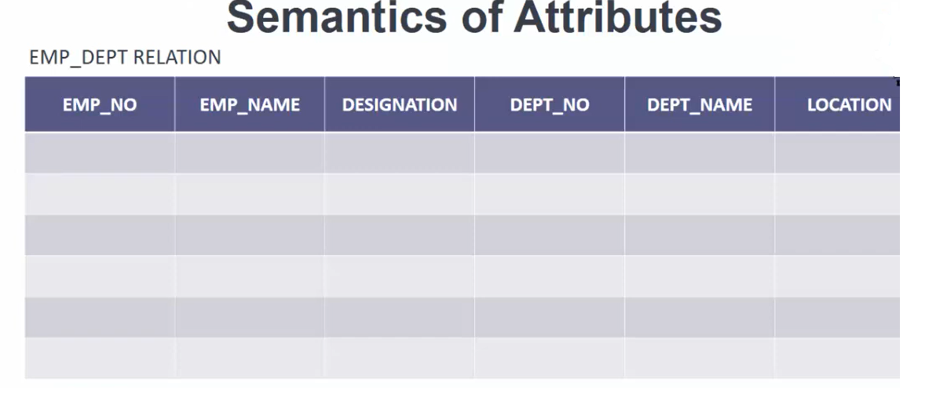
In the following example information about two entities are clubbed together which is not desirable

Slide 5
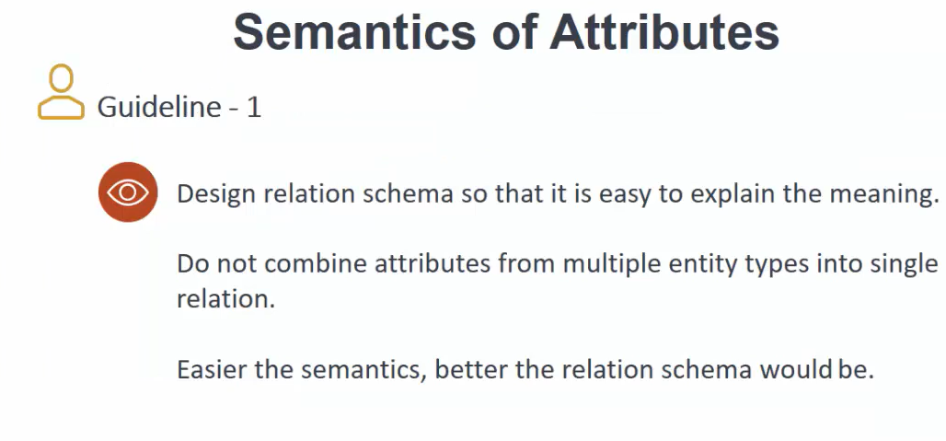

Slide 6
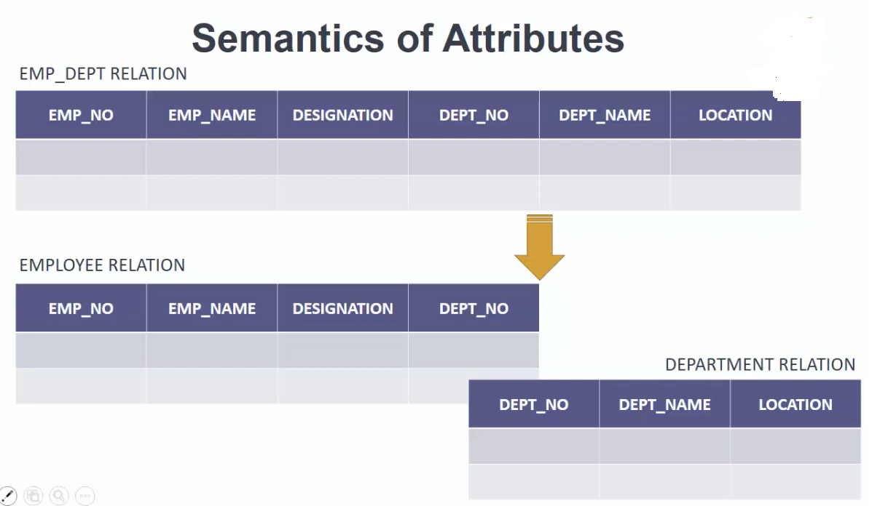

Slide 7
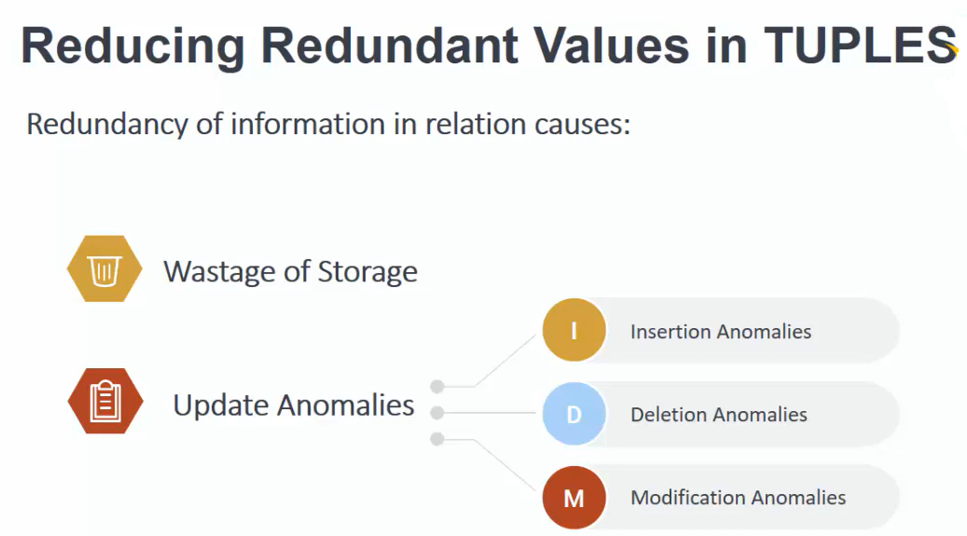

Slide 8
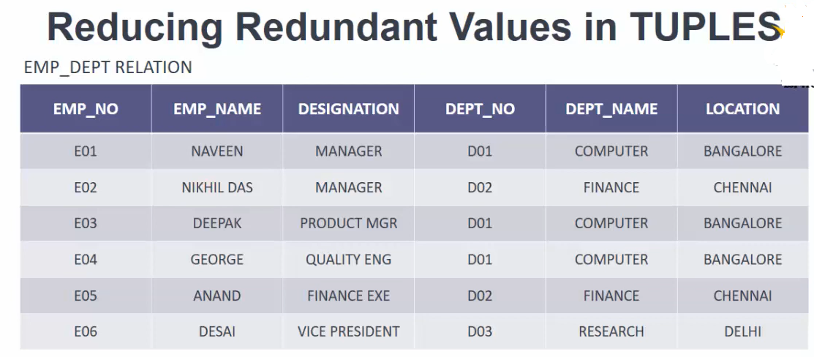

Slide 9
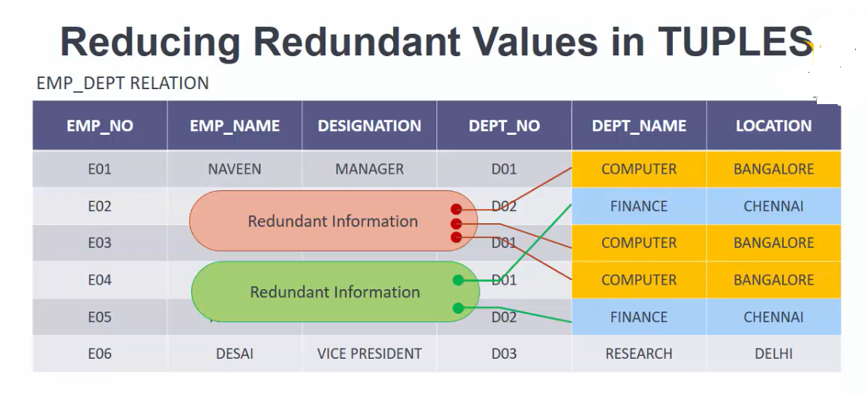

Slide 10
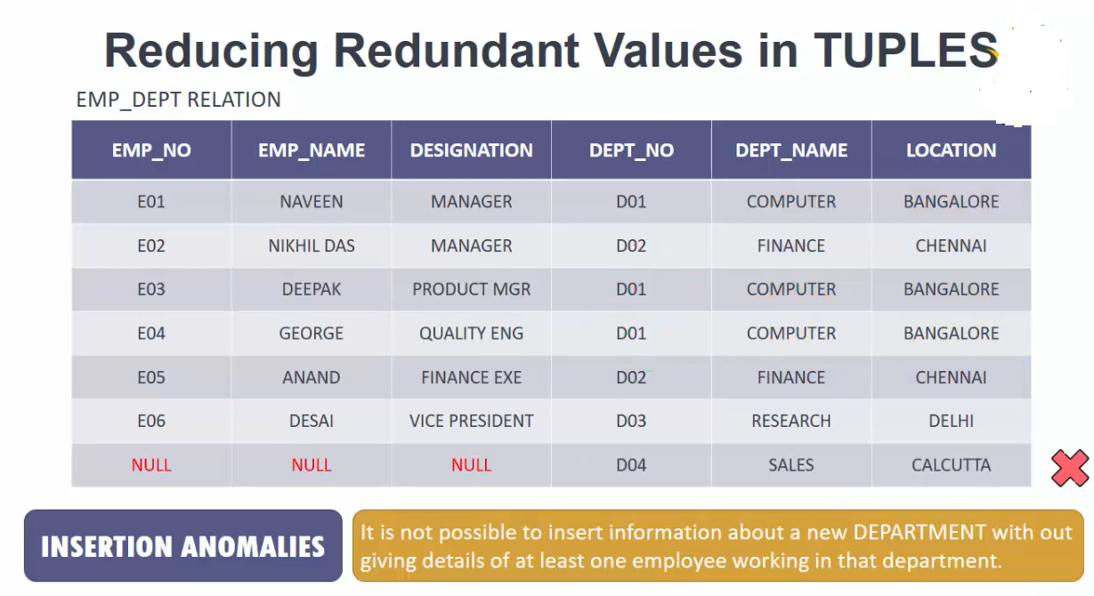

Slide 11
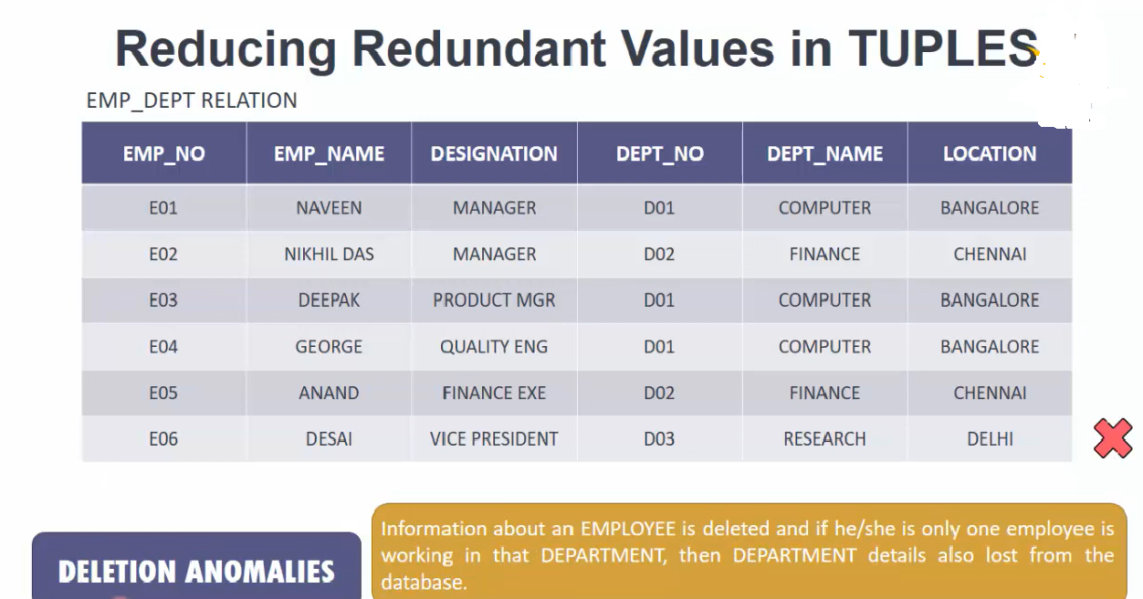

Slide 12
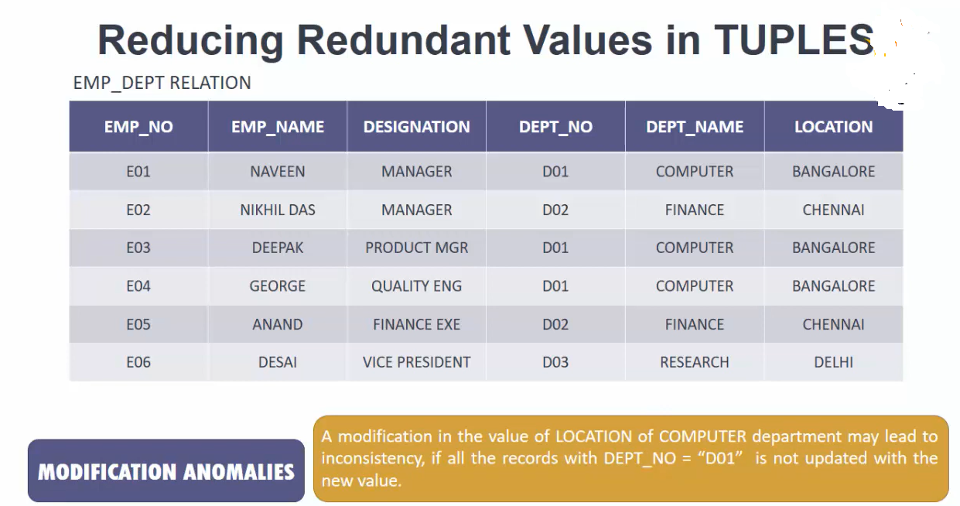

Slide 13
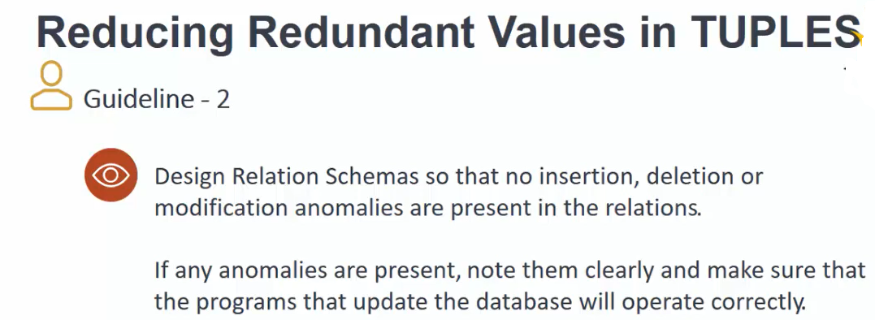

Slide 14
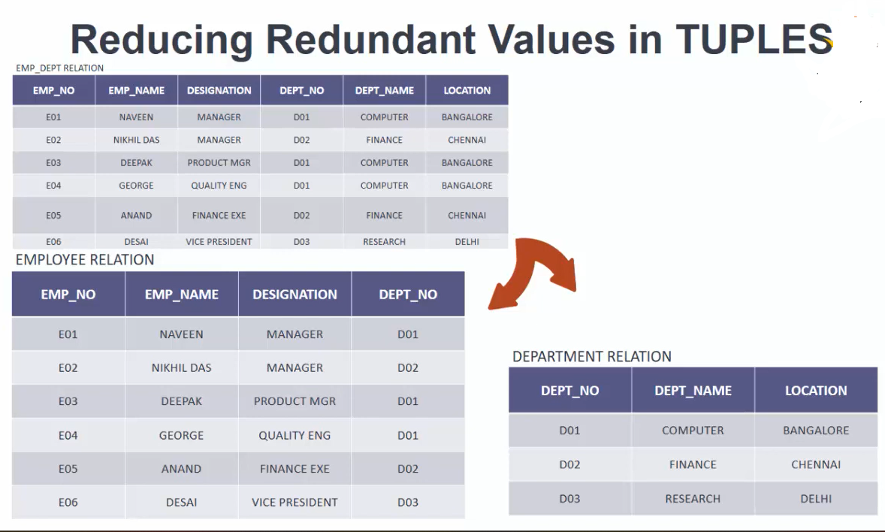

Slide 15
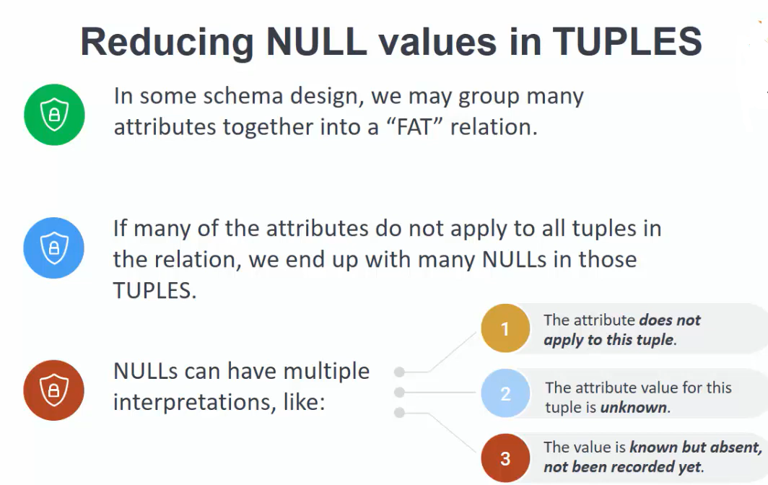

Slide 16
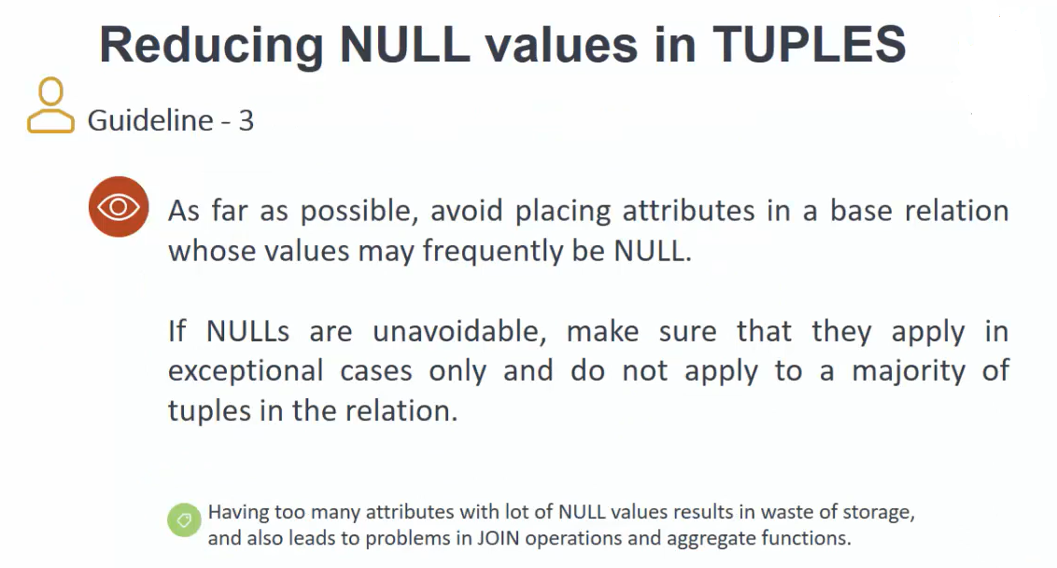

Slide 17
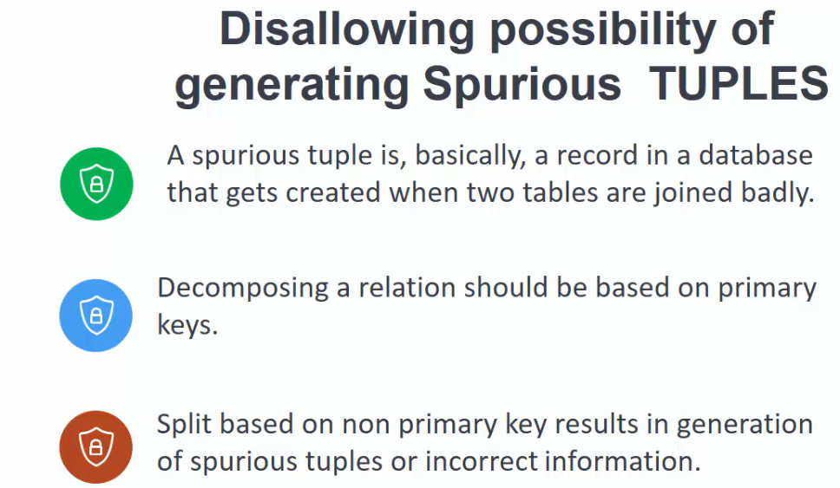

Slide 18
